Slide 1
AQUATHON_ 2023
PROBLEM STATEMENT NAME: AUTOMATIC FISH FEEDER USING AI
TEAM DETAILS: ( DEPT OF AI&DS)
TEAM LEAD: B. PRUDHVI NARAYANA
MEMBER 1: M.BHARGAV
MEMBER 2: B.HARSHITHA
MEMBER 3: B.CHETAN CHANDRA
MEMBER 4: S.BHARAT KUMAR

Slide 2
Description of problem statement:
The purpose of a smart automatic fish feeder is to make it easier for fish owners to ensure that their fish are being fed the correct amount at regular intervals, even when the owner is away. This can help to keep fish healthy and reduce the risk of overfeeding or underfeeding.

Slide 3
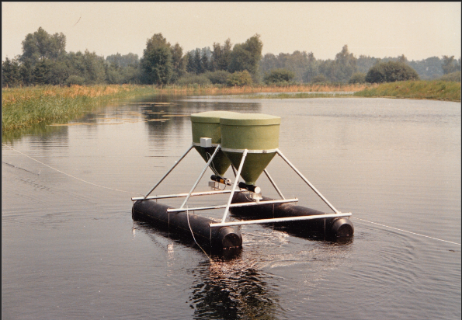
Existing Technologies/Services:
Computer Vision mainly uses image recognition to find the density of the fishes in the given area.
Machine learning Algorithms for Finding the no of fishing in the given densities.
Machine learning Algorithms includes ANNs, SVMs, Random Forest, k-Nearest Neighbours (k-NN).
The existing technologies are concerned with waters which are transparent.
They do not deal with the waters that are not transparent,i.e, especially in the ponds containing traces of algae they are not at all useful in those muddy waters.

Slide 4
Proposed solution:
To remove the problem of fish detection in non-transparent waters, The idea of using SONAR as an alternative for image recognition as in the conventional methods gives a great advantage for machine learning algorithms to estimate the amount of food to be given.
So using the combination of image recognition, detection using SONAR and frequency calculation of the pond together will result in the accurate working of the machine learning algorithms.
Since the whole project will be floating on the pond it is easy for it to move from place to place and can cover maximum area of the pond which is used to detect food estimations for large ponds.

Slide 5
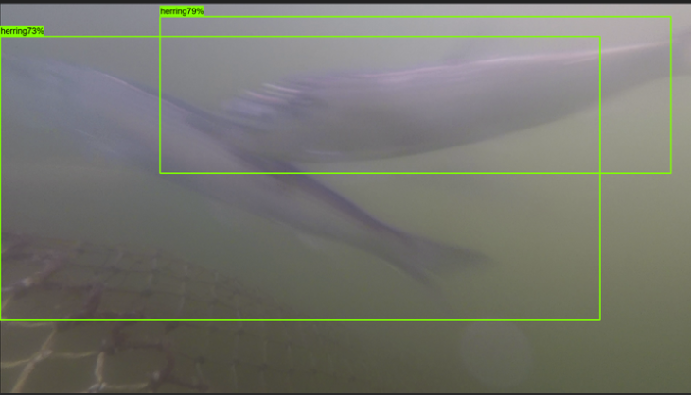
Sonar Technology
Fish Size Via Computer vision:

Slide 6
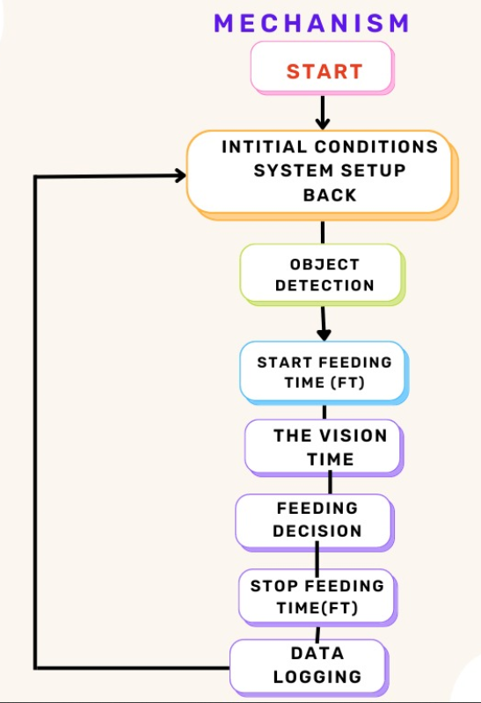
Flow chart:

Slide 7
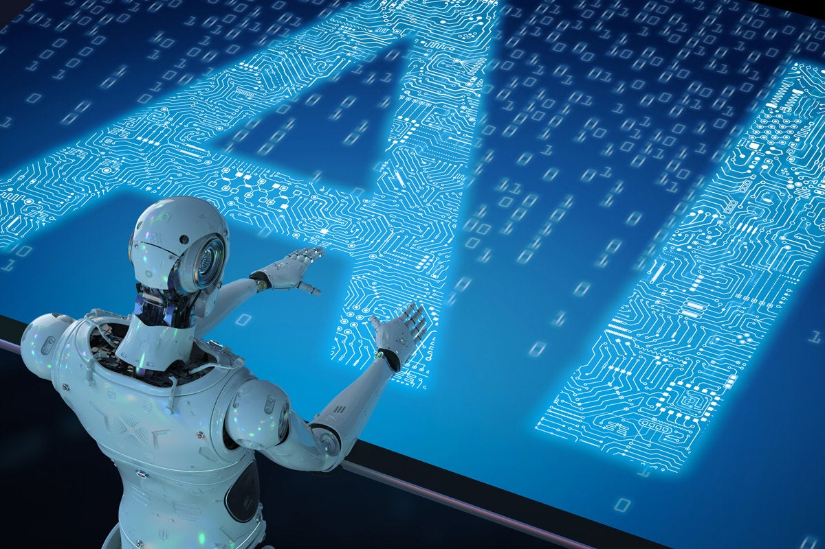

Slide 8
Technologies :
Computer Vision (Image Recognition).
Sonar Technology for finding the frequency within an area. Sonar technology acts as an alternative to image processing in case of Waters which are not transparent.
Machine learning Algorithms for Finding the no of fishing in the given densities.
Machine learning Algorithms includes ANNs, SVMs, Random Forest and k-Nearest Neighbours (k-NN).
Note: that the choice of the algorithm will depend on the specific characteristics of the sonar data, the size of the pond, and the specific information needed.

Slide 9
Conclusion:
The Advantages By using Ai packed Smart Fish Feeder:
Automation
Improved feeding efficiency
Better fish health
Cost-effective
Remote monitoring

